Slide 1
PUBLIC TRANSPORT OPTIMIZATION
TEAM MEMBERS:
VARSHA V(113321104110)
VELAVALURU RAJITHA SAI(113321104112)
VELURU PRIYADHARSHINI(113321104113)
YADDALA HARSHITHA(113321104117)
YUVASHREE S(113321104120)

Slide 2
PROJECT DESCRIPTION
The objectives of the public transport is optimization should make the possibilities of cost effectiveness, safety, and other important measures are as follows
Enhance Reliability: To ensure that the passengers should not waste there time by making the passengers to get information of the transport details.
Enhance Safety and Security: To implement safety measures for the passengers and staffs.
Financial Sustainability: To optimize the cost-effectiveness in the public transport services.
Data-Driven Decision-Making: To collect and analyze data on passengers f bws, route performance, and other measures to inform decision-making.
Creating a public transport optimization using IoT (Internet of Things) involves a combination of hardware, software, and connectivity. While web development technologies may not be the only requirement, they can play a crucial role in creating a user interface for monitoring and controlling the transport system

Slide 3
PLATFORM REQUIRED
Geographic Information System (GIS) Software: GIS software like ArcGIS or QGIS can help you manage and analyze spatial data, such as transportation networks, routes, and geographic information.
Data Collection and Analysis Tools: Tools for collecting and analyzing data related to passenger demand, route utilization, and traffic patterns are crucial. This can include survey tools, data visualization software, and statistical analysis packages.
Transport Planning and Optimization Software: Specialized software like PTV Visum or Cube Voyager can assist in optimizing routes, schedules, and vehicle allocation.

Slide 4
Real-time Data Platforms: Utilize platforms that provide real-time data for tracking vehicles and monitoring traffic conditions. These platforms often involve GPS tracking and communication systems.5.
Mobile App Development Tools: If your project includes developing a public transport app, you'll need app development tools and programming languages like Android Studio (for Android apps) or Xcode (for iOS apps).6.
Cloud Computing Services: Cloud platforms such as Amazon Web Services (AWS) or Microsoft Azure can be used for data storage, processing, and hosting applications.
Database Management Systems: Databases like PostgreSQL, MySQL, or NoSQL databases are essential for storing and managing large amounts of transportation data.
Simulation Software: Simulation tools like Any Logic or Simul8 can be helpful for modeling and testing various scenarios.
Communication and Information Dissemination Platforms: Consider platforms for passenger information, such as websites, mobile apps, or digital signage systems.
Transportation Management Systems (TMS): TMS software helps manage transportation operations and logistics, including vehicle scheduling, driver assignments, and route optimization.

Slide 5
WEB DEVELOPMENT TECHNOLOGIES
Front-End Development:
HTML, CSS, JavaScript: These are the fundamental technologies for building user interfaces.
React, Angular, or Vue.js: Use a modern JavaScript framework to create interactive and responsive web interfaces.
Responsive Design: Ensure that your web application works well on various devices and screen sizes.

Slide 6
Back-End Development:
Node.js, Python, or Java: Choose a suitable backend programming language for your IoT data processing and API development.
Express.js, Django, or Spring Boot: These are popular frameworks that can help you create robust APIs.
RESTful APIs: Design APIs for communication between IoT devices and the server.
Database:
SQL or NoSQL Database: Depending on your data model, you might need a relational database (e.g., PostgreSQL, MySQL) or a NoSQL database (e.g., MongoDB) to store data.

Slide 7
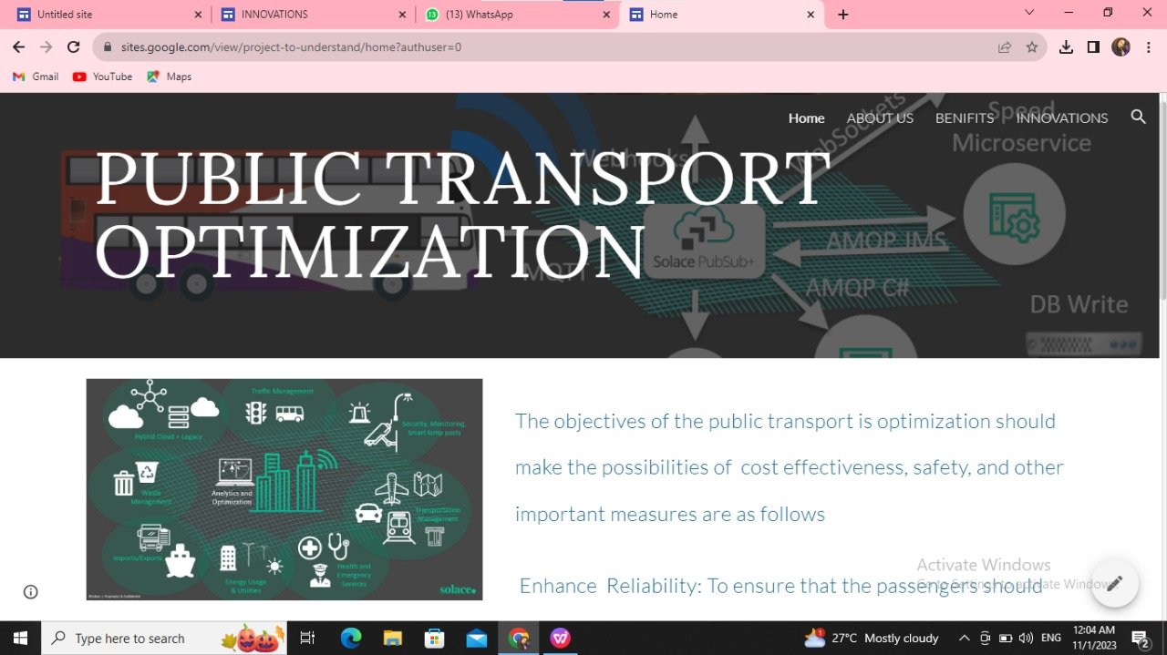
WEBSITE LINK: https://sites.google.com/view/project-to-understand/innovations

Slide 8
CONCLUSION
In conclusion, optimizing public transport is essential for addressing urban mobility challenges, reducing traffic congestion, lowering carbon emissions, and enhancing the overall quality of life for city residents. By implementing efficient routes, integrating smart technologies, and promoting sustainable alternatives, cities can create a more accessible, eco-friendly, and convenient public transportation system that benefits both passengers and the environment. This optimization not only improves transportation but also contributes to building more sustainable and livable urban space.

